Slide 1

DEPARTMENT OF COMPUTER SCIENCE & ENGINEERING
SCHOOL OF COMPUTING
1156CS701- MAJOR PROJECT
WINTER SEMESTER 22-23
INTERNSHIP THROUGH DIND
BOSTON IT SOLUTION INDIA PRIVATE LIMITED
SEMESTER END PROJECT VIVA VOICE EXAMINATIONS
“PROFILING AND CUSTOMER SEGMENTATION FOR FMCG-
RETAIL INDUSTRY BASED ON SOCIAL MEDIA DATA”
SUPERVISED BY
Dr.S.JAGAN
PROFESSOR
PRESENTED BY
1.K.SUBBA REDDY(15489)(19UECS0439)
2.V.RAJA SEKHAR REDDY(13515)(19UECS1026)
3.M.JAGADISH(15719)(19UECS0595)

Slide 2
INDUSTRY DETAILS
Industry Name/Institute Name : Boston IT Solution India Private Limited
Duration of Internship (20-01-23 - 25-05-23)
Duration of Internship in Months : 5 Months
Industry Guide Name & Designation : Rethish Vaar

Slide 3
AGENDA
ABSTRACT
OBJECTIVE
INTRODUCTION
LITERATURE REVIEW (SOFT COPY OF PAPERS TO BE LINKED AS HYPERLINK)
DESIGN AND METHODOLOGIES
IMPLEMENTATION
TESTING
INPUT AND OUTPUT
INCLUDE DEMO VIDEO(You Tube URL of complete demonstration of project)
CONCLUSION
FUTURE ENHANCEMENTS
WEB REFERENCES LINK
REFERENCES
PLAGIARISM REPORT OF PPT
INCLUDE YOUR 2 PHOTOS OF YOUR INDUSTRY WORKING ENVIRONMENT
INTERNSHIP CERTIFICATE(Offer Letter and Completion certificate)
POSTER PRESENTATION
JOURNAL/CONFERENCE PUBLICATION PROOF(MANDATORY TO ATTACH)

Slide 4
ABSTRACT
We are interested in predicting a sizable collection of time series for FMCG demand. Due to the hierarchy of FMCG demand (from producers to distributors).
The bottom level of the hierarchy, which is most relevant to merchants, may have thousands or even millions of time series. It becomes technically difficult to produce reliable aggregate forecasts while exploiting the distinctive properties of each time series. Exploratory analysis is frequently required to learn more about the underlying demand generating process for each time series in order to improve predicting outcomes. Exploratory analysis looks for the so-called "exogenous factors" that can explain some of the variations in demand, such as price, demand for complementary or substitutable commodities, and calendar events.

Slide 5
OBJECTIVES
Aim & Scope of The Project :
customer segmentation is the practise of grouping the consumers of a firm into categories that represent the similarities among the customers in each category. In order to optimise each customer's value to the company, it is important to segment customers in order to determine how to interact with them.

Slide 6
INTRODUCTION
For producers, distributors, and retailers of fast-moving consumer goods (FMCG), stock-outs have been a problem.a long time. Overstock situations are likewise undesirable since FMCG products are not durable. Prices for deteriorating products are frequently drastically lowered to increase demand, which results in a loss of potential revenues . Enterprises aim to reduce, if not completely eliminate, stock-outs and overstocks in the increasingly cutthroat retail business of today. Stock-outs have a direct impact on customer loyalty, while overstocks result in high inventory costs and wastage.So, in order to maximise efficiency and enhance the quality of customer service, FMCG manufacturers, distributors, and retailers must coordinate their efforts in the supply chain management processes

Slide 7
LITERATURE REVIEW
Emre DÜNDER Mehmet Ali CENGİZ 2020, In the context of generalized linear modelling (GLM), the beta regression analysis is used to estimate regression models when the dependent variable lies between (0,1). In this paper, we carried out a model selection process using several information criteria with heuristic optimization. We employed the differential evolution algorithm as a heuristic optimization method to select the best model for beta regression analysis. The results show that the alternative-type information criteria provide competitive results during the model selection process in beta regression analysis.

Slide 8
LITERATURE REVIEW
Rob J. Hyndman 2019, Many statistical methods involve summarizing a probability distribution by a region of the sample space covering a specified probability. One method of selecting such a region is to require it to contain points of relatively high density. Highest density regions are particularly useful for displaying multimodal distributions and, in such cases, may consist of several disjoint subsets-one for each local mode. In this paper, I propose a simple method for computing a highest density region from any given (possibly multivariate) density f(x) that is bounded and continuous in x. Several examples of the use of highest density regions in statistical graphics are also given. A new form of boxplot is proposed based on highest density regions; versions in one and two dimensions are given. Highest density regions in higher dimensions are also discussed and plotted

Slide 9
LITERATURE REVIEW
K. R. GABRIEL 2021, Any matrix of rank two can be displayed as a biplot which consists of a vector for each row and a vector for each column, chosen so that any element of the matrix is exactly the inner product of the vectors corresponding to its row and to its column. If a matrix is of higher rank, one may display it approximately by a biplot of a matrix of rank two which approximates the original matrix. The biplot provides a useful tool of data analysis and allows the visual appraisal of the structure of large data matrices. It is especially revealing in principal component analysis, where the biplot can show inter-unit distances and indicate clustering of units as well as display variances and correlations of the variables.

Slide 10
LITERATURE REVIEW
Alberto Rodríguez Casal 2010, This paper presents the R package alphahull which implements the α-convex hull and the α-shape of a finite set of points in the plane. These geometric structures provide an informative overview of the shape and properties of the point set. Unlike the convex hull, the α-convex hull and the α-shape are able to reconstruct non-convex sets. This flexibility make them specially useful in set estimation. Since the implementation is based on the intimate relation of theses constructs with Delaunay triangulations, the R package alphahull also includes functions to compute Voronoi and Delaunay tesselations. The usefulness of the package is illustrated with two small simulation studies on boundary length estimation.

Slide 11
LITERATURE REVIEW
Himanshu Mishra 2013, This paper investigates how changing the value of one attribute while keeping other attributes constant influences consumers' judgments and behaviors. We find that in two options, a proportionally equal change in one attribute tilts people's preference toward the option with higher (or lower) absolute magnitude of change when the change is desirable (or undesirable). We propose that when individuals face an attribute change, they use a deliberative and effortful response, known as System 2, to detect the change. However, they rely less on this system to evaluate the changed options. Instead, a more automatic System 1 processing influences their decision by making them apply the bigger-is-better heuristic (bigger-is-worse for an undesirable change) to prefer the option with the highest (lowest) absolute magnitude of change. Six studies demonstrate this phenomenon in both lab and real settings and support our hypothesis. Copyright © 2013 John Wiley & Sons, Ltd.

Slide 12
DESIGN AND METHODOLOGIES
DATA COLLECTION
DATA PRE-PROCESSING
FEATURE EXTRATION
EVALUATION MODEL
Data collection
Data collection is a process in which information is gathered from many sources which is later used to develop the machine learning models. The data should be stored in a way that makes sense for problem. In this step the data set is converted into the understandable format which can be fed into machine learning models.

Slide 13
Data pre-processing
Three common data pre-processing steps are:
Formatting: The data you have selected may not be in a format that is suitable for you to work with. The data may be in a relational database and you would like it in a flat file, or the data may be in a proprietary file format and you would like it in a relational database or a text file.
Cleaning: Cleaning data is the removal or fixing of missing data. There may be data instances that are incomplete and do not carry the data you believe you need to address the problem. These instances may need to be removed. Additionally, there may be sensitive information in some of the attributes and these attributes may need to be anonymized or removed from the data entirely.
Sampling: There may be far more selected data available than you need to work with. More data can result in much longer running times for algorithms and larger computational and memory requirements. You can take a smaller representative sample of the selected data that may be much faster for exploring and prototyping solutions before considering the whole dataset.

Slide 14
Evaluation Model
Model Evaluation is an integral part of the model development process. It helps to find the best model that represents our data and how well the chosen model will work in the future. Evaluating model performance with the data used for training is not acceptable in data science because it can easily generate overoptimistic and over fitted models. There are two methods of evaluating models in data science, Hold-Out and Cross-Validation. To avoid over fitting, both methods use a test set (not seen by the model) to evaluate model performance.Performance of each classification model is estimated base on its averaged. The result will be in the visualized form. Representation of classified data in the form of graphs. Accuracy is defined as the percentage of correct predictions for the test data. It can be calculated easily by dividing the number of correct predictions by the number of total predictions.

Slide 15
Feature Extraction
Next thing is to do Feature extraction is an attribute reduction process. Unlike feature selection, which ranks the existing attributes according to their predictive significance, feature extraction actually transforms the attributes. The transformed attributes, or features, are linear combinations of the original attributes. Finally, our models are trained using Classifier algorithm. We use classify module on Natural Language Toolkit library on Python. We use the labelled dataset gathered. The rest of our labelled data will be used to evaluate the models. Some machine learning algorithms were used to classify pre-processed data. The chosen classifiers were Random forest. These algorithms are very popular in text classification tasks

Slide 16
STANDARDS & POLICIES
The FMCG industry had a few eventful years that demonstrated just how quickly these products can move—even those you wouldn’t anticipate flying off the shelves. This results in a difficult-yet-exciting market when combined with some supply chain problems and understaffed warehouses.
ISO 22000 sets out the requirements for a food safety management system and can be certified to it. It maps out what an organization needs to do to demonstrate its ability to control food safety hazards in order to ensure that food is safe. It can be used by any organization regardless of its size or position in the food chain.

Slide 17
IMPLEMENTATION
ARCHITECTURE DIAGRAM
DATA FLOW DIAGRAM
ER DIAGRAM
SEQUENCE DIAGRAM
COLLABORATION DIAGRAM
USE CASE DIAGRAM
CLASS DIAGRAM
ACTIVITY DIAGRAM

Slide 18
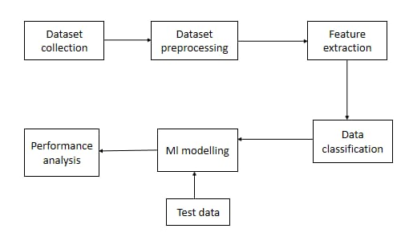
ARCHITECTURE DIAGRAM

Slide 19
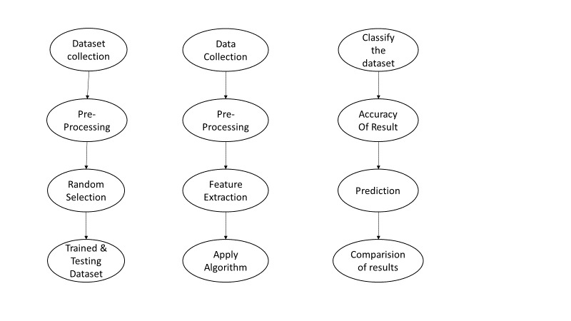
DATA FLOW DIAGRAM

Slide 20
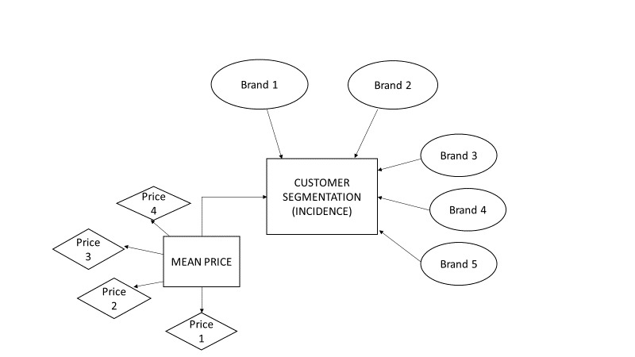
ER DIAGRAM
.

Slide 21
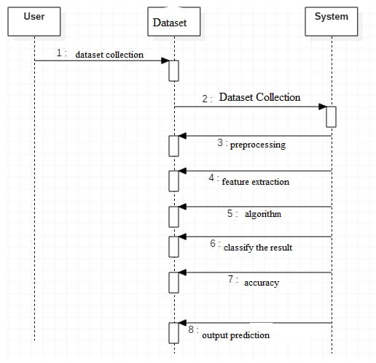
SEQUENCE DIAGRAM

Slide 22
COLLABORATION DIAGRAM
System
1. Pre processing
2. Feature extraction
3. Data visualization
4. Train and test
5. Machine learning model
Data
1. Collecting dataset
User
1. Giving input data
2. Predict future

Slide 23
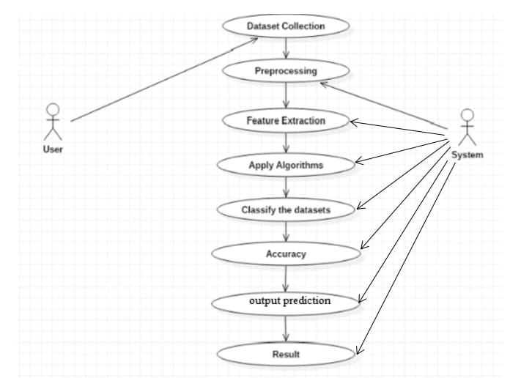
USE CASE DIAGRAM

Slide 24
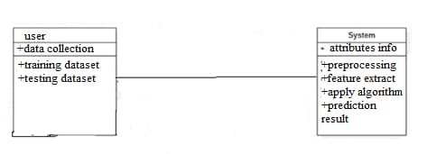
CLASS DIAGRAM

Slide 25
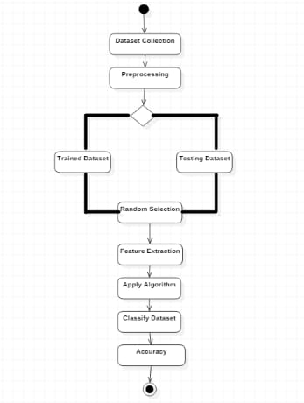
ACTIVITY DIAGRAM

Slide 26
TESTING
UNIT TESTING
A software testing technique known as unit testing involves testing individual software units, such as groups of computer programme modules, usage procedures, and operating procedures, to see if they are acceptable for use. It is a testing technique whereby the developer himself tests each individual module to ascertain whether there is a problem. It has a relationship on how well the individual modules perform. Software testing known as "unit testing" involves testing individual programme components. When developing an application, unit testing is done on the software product. An individual component could be a technique or a specific function.
INTEGRATION TESTING
Software integration testing is the incremental integration testing of two or more integrated software components on a single platform to produce failures caused by interface defects.

Slide 27
FUNCTIONAL TESTING
Functional tests provide systematic demonstrations that functions tested are available as specified by the business and technical requirements, system documentation, and user manuals.
WHITE BOX TESTING
White box testing is a technique that enables testers to examine and validate a software system's internal operations, including its code, infrastructure, and integrations with external systems. An automated build method for a modern Continuous Integration/Continuous Delivery (CI/CD) development pipeline must include white box testing.

Slide 28
BLACK BOX TESTING
Black box testing is a technique for testing software applications' functionalities without having access to their underlying code structure, implementation specifics, or internal routes. Black Box Testing is totally based on software requirements and standards and primarily concentrates on the input and output of software programmes. Also called behavioural testing.

Slide 29
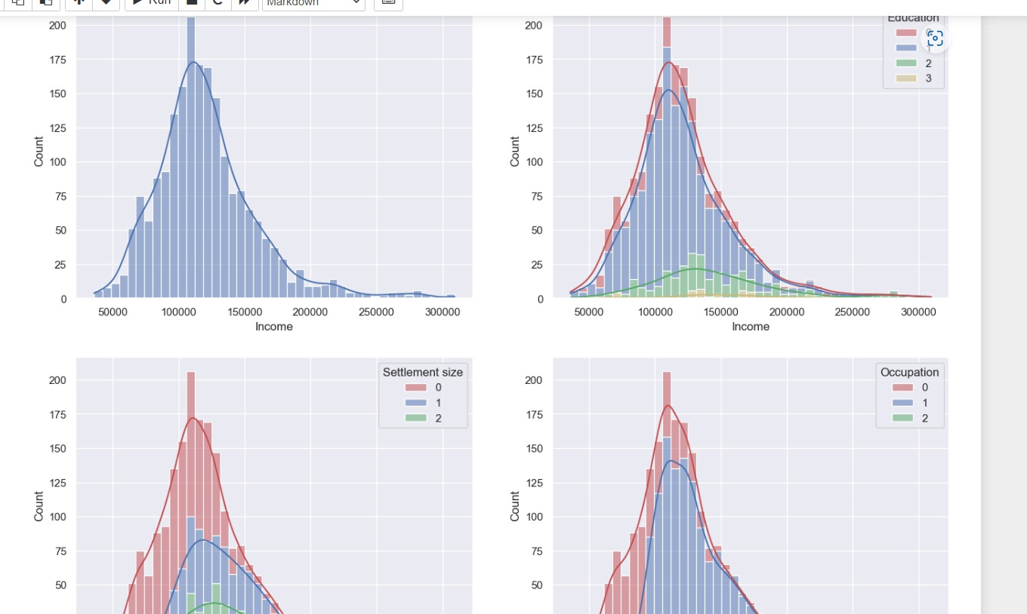
INPUT AND OUTPUT

Slide 30
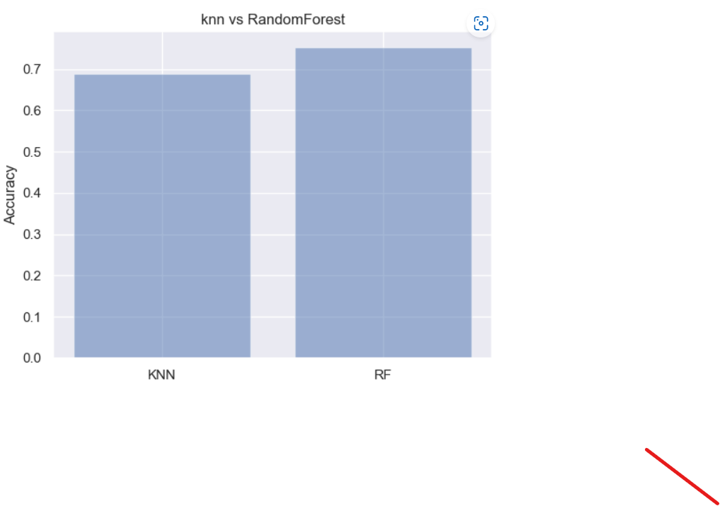
OUTPUT

Slide 31
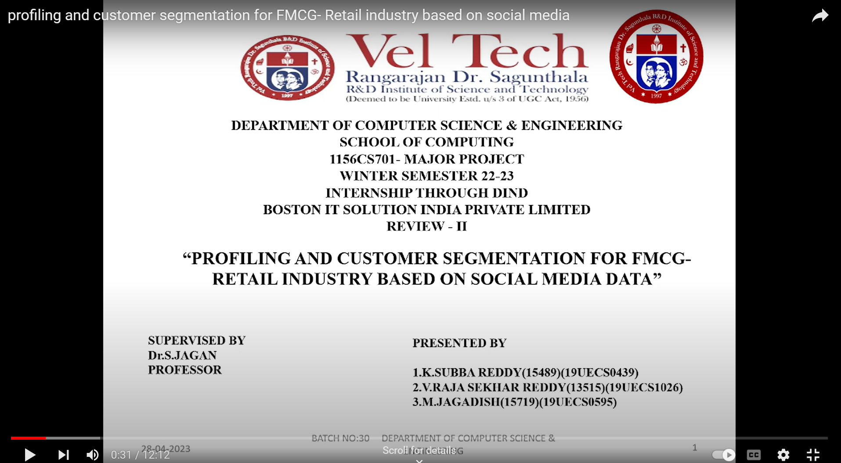
DEMO VIDEO

Slide 32
CONCLUSION
In manufacturing supply chains, huge time series data are frequently present because of the hierarchical nature of the demand (from manufacturers through distributors to retailers). In order to find important knowledge and information hidden in the data, several exploratory analytics and visualisation tools are suggested in this study.When a single time series is of interest, we advise superimposing exogenous elements (such as pricing and promotion data) over the demand time series so that the relationship between the factors and demand may be visually examined. We advise using the kite plot when working with a reasonably significant amount of time series. Examining similarities between different time series and the availability of data is possible.

Slide 33
FUTURE ENHANCEMENTS
The FMCG (Fast Moving Consumer Goods) or Consumer Packed Goods (CPG)industry represents one of the largest industries worldwide.
As per a study, the FMCG industry is well positioned to register a growth primarily driven by the rising consumption of ready-to-eat food products.
We advise using the kite plot when working with a reasonably significant amount of time series. Examining similarities between different time series and the availability of data is possible.

Slide 34
WEB REFERENCES/VIDEO LINKS
VIDEO LINK
https://youtu.be/N9OeLCyoydo
WEB REFERENCES https://in.search.yahoo.com/search?fr=mcafee&type=E211IN826G0&p=PROFILING+AND+CUSTOMER+SEGMENTATION+FOR+FMCG-+RETAIL+INDUSTRY+BASED+ON+SOCIAL+MEDIA+DATA

Slide 35
REFERENCES(as per IEEE format only)
W. E. Wecker, “Predicting demand from sales data in the presence of stockouts,” Management Science, vol. 24, no. 10, pp. 1043–1054, 1978.
A. Chande, S. Dhekane, N. Hemachandra, and N. Rangaraj, “Perishable inventory management and dynamic pricing using RFID technology,” Sadhana, vol. 30, no. 2-3, pp. 445– 462, 2005.
F. R. Jacobs and R. B. Chase, Operations and Supply Chain Management. Mcgraw Hill, 2010.
X. Wu, X. Zhu, G.-Q. Wu, and W. Ding, “Data mining with big data,” Knowledge and Data Engineering, IEEE Transactions on, vol. 26, no. 1, pp. 97–107, Jan. 2014.
D. Yang, G. S. W. Goh, S. Jiang, and A. N. S. Zhang, “Forecast UPC-level FMCG demand, Part II: Hierarchical reconciliation,” in Big Data (Big Data), 2015 IEEE International Conference on, Oct 2015.
T. Huang, R. Fildes, and D. Soopramanien, “The value of competitive information in forecasting FMCG retail product sales and the variable selection problem,” European Journal of Operational Research, vol. 237, no. 2, pp. 738–748, 2014.
R. C. M. Daniel Toro-González, Jill J. McCluskey, “Beer snobs do exist: Estimation of beer demand by type,” Journal of Agricultural and Resource Economics, vol. 39, no. 2, pp. 174–187, 2014.

Slide 36
Gopalan, S., Datar, M., & Garg, R. (2018). Segmentation of FMCG customers using social media data: A case study of a leading retail chain. International Journal of Information Management, 39, 39-50.
Yang, Y., & Liu, H. (2019). Profiling customers of a Chinese FMCG retailer based on social media data. Journal of Retailing and Consumer Services, 50, 121-127.
Wang, L., & Qiu, L. (2019). Customer segmentation and profiling based on social media data in the Chinese FMCG retail industry. International Journal of Information Management, 45, 116-126.
Lin, J., & Liu, J. (2017). Customer profiling and segmentation based on social media data: A case study of a Chinese FMCG retailer. Journal of Retailing and Consumer Services, 34, 21-29.
Zhang, W., & Liu, X. (2019). Customer segmentation in the FMCG industry using social media data: A case study of a Chinese retail company. Journal of Business Research, 104, 506-514.

Slide 37
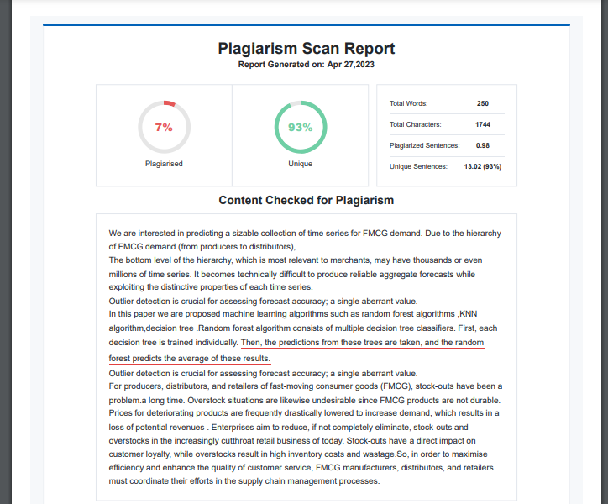
Plagiarism Report of PPT

Slide 38
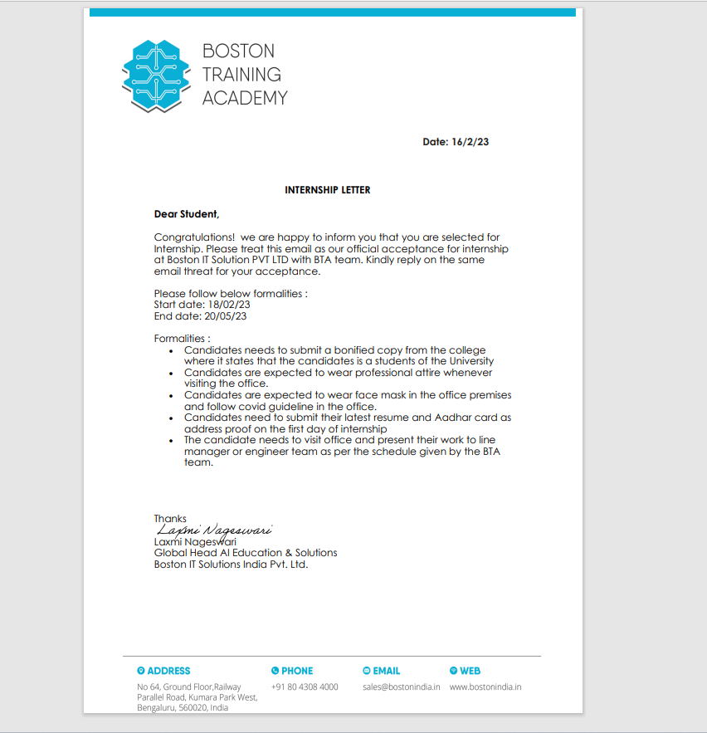
INTERNSHIP CERTIFICATE
OFFER LETTER

Slide 39
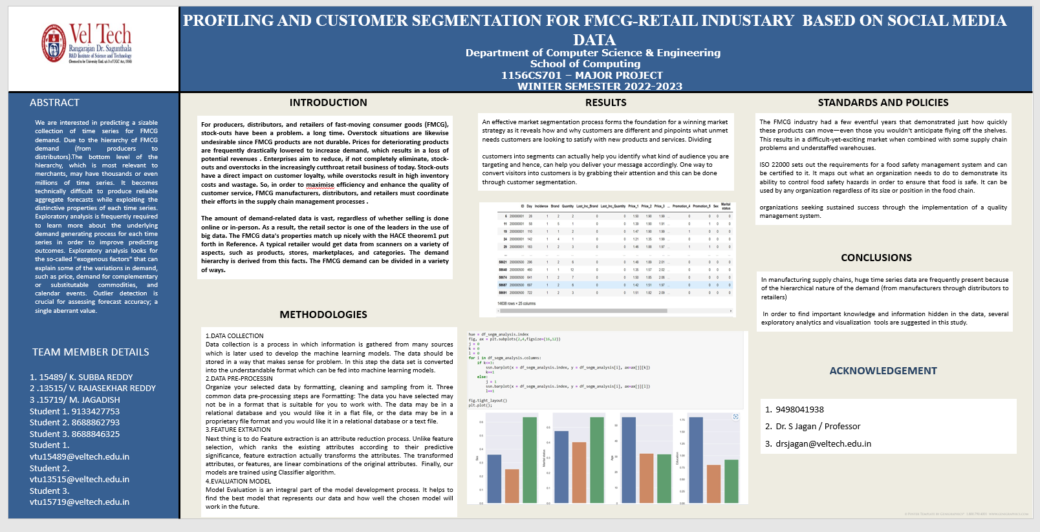
POSTER PRESENTATION

Slide 40
THANK YOU

